Slide 1



Mission Sisterhood
Part One

Slide 2
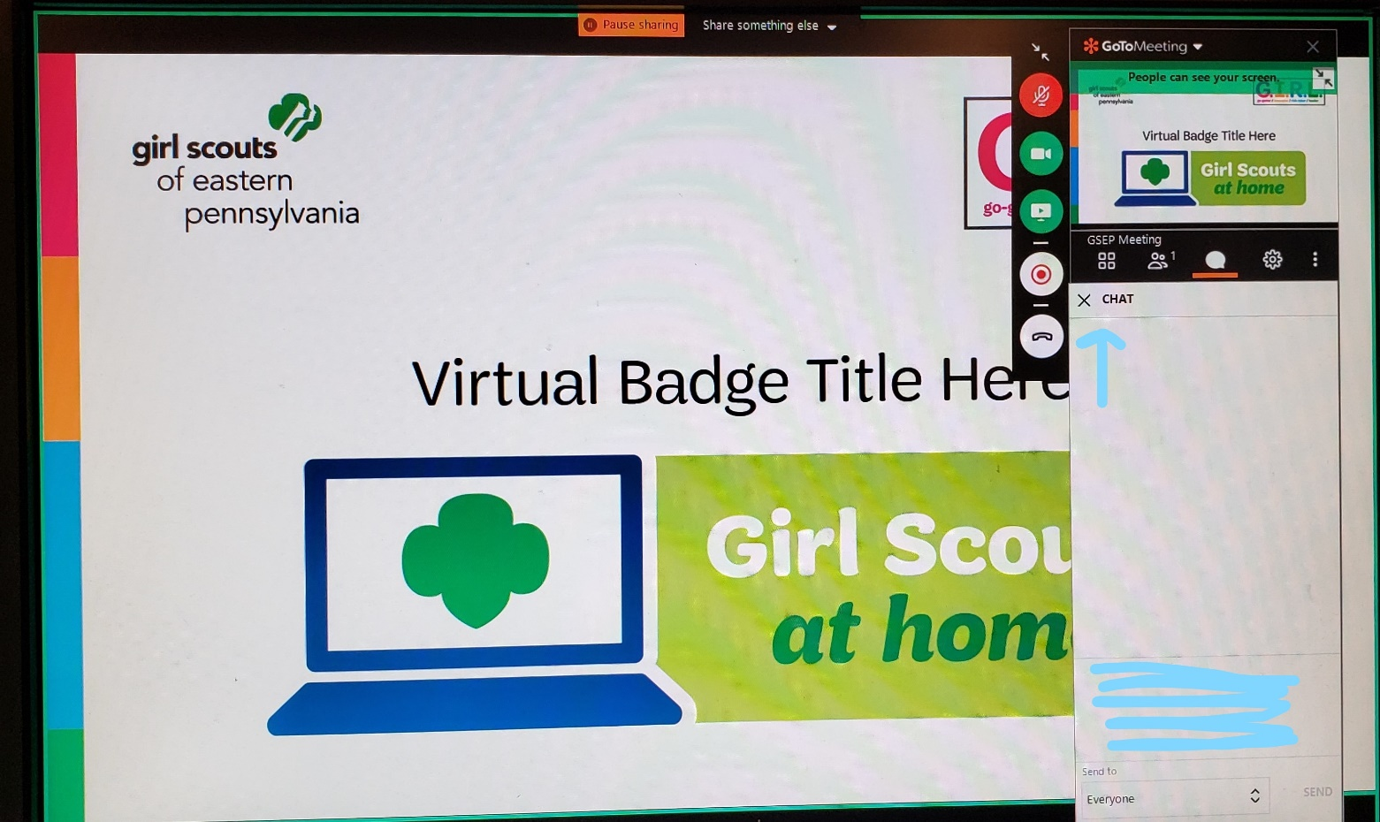
How will this Virtual Troop Meeting Work?
On the right side of your screen, there is a control panel. You should see a microphone, a video camera and a chat bubble.
When we sing together, you will want to click on your microphone so it is green. Then everyone will be able to hear you.
If you have a webcam, clicking on it will let everyone else in the meeting see you too.
The Chat Log looks like a cartoon thought bubble…see it underlined in red? You can type questions or comments into the chat log and everyone will be able to see what you write!
Notes:
And keep in mind…

Slide 3
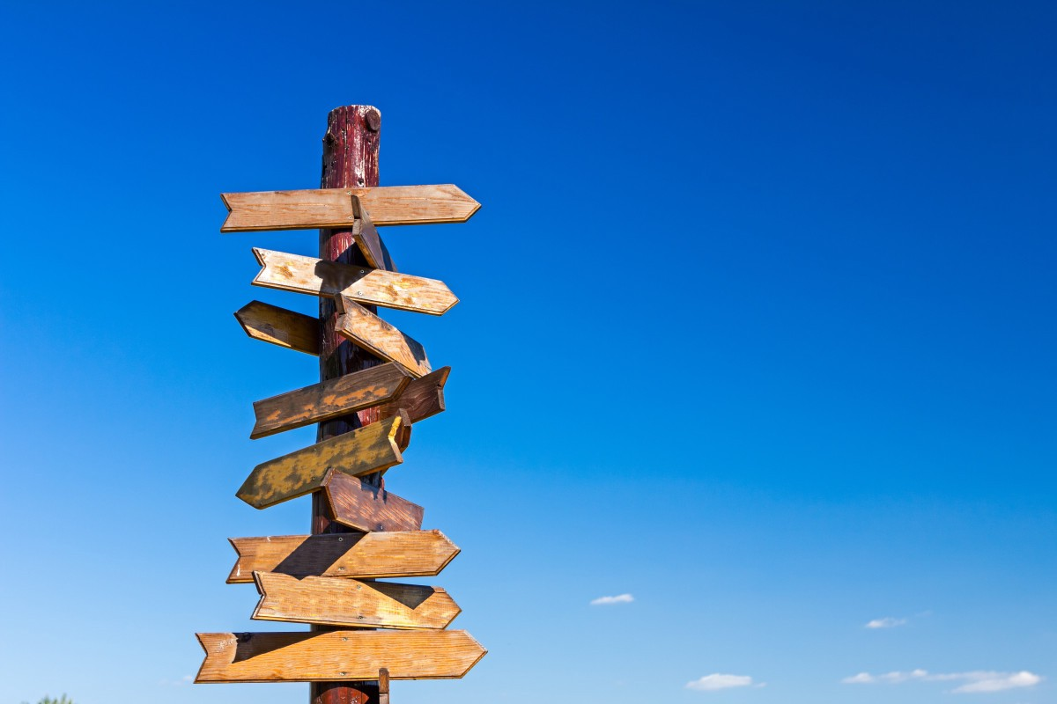
Slide Title
Meeting Norms:
-Staying muted unless asked to unmute by the presenter
-Only using the chat log for VTM related messages
-Use of appropriate language during VTMs
-Behavior modelling the GS Promise and Law
Notes:
And keep in mind…

Slide 4


Girl Scout Promise
and Law

Slide 5
Mission Sisterhood
Mission sisterhood is about connecting to people and making the right choices
Discover your values
Connect with others
Take action: developing a plan to make a positive change in our community

Slide 6
Sisterhood
What is Sisterhood?
We will break into groups to show our visual representation of what Sisterhood means to us.
Notes:
Their visual representation is something they brought with them to the meeting

Slide 7

Notes:
We will be working on what sisterhood means and what our Sisterhood looks like to us,
Who has a definition for Sisterhood?
Who wants to add something to this definition?
GOAL: A sisterhood is a network of people we surround ourselves with to build us up, support us, challenge us, and we do the same for those within our sisterhood.
We do not want people who are going to make us feel bad, up us down, treat us poorly, or be fake.
and if there are any changes we need to our definition we can add them as we go along

Slide 8
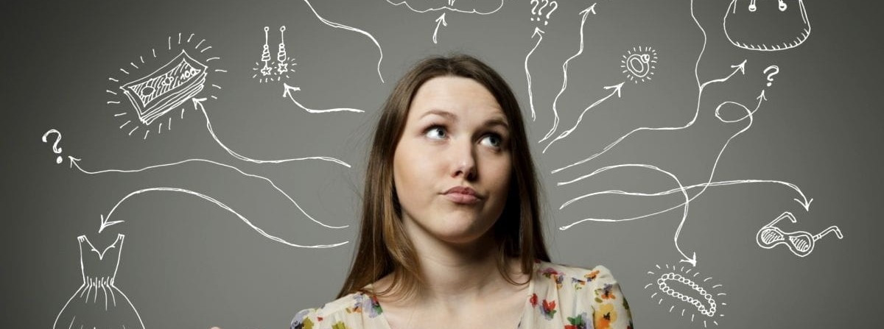
Understanding Ourselves
When creating our Sisterhood we have to understand ourselves
We have to be positive to ourselves
We have to understand our values and needs

Slide 9

Mirror, Mirror
Three things you like about your personality (i.e. kindness).
Three parts of your body that you like because of what they can do (i.e. legs because they can let me run).
Three parts of your body you like the look of (i.e. arms or stomach).
Notes:
Write down these items, we will take 5 minutes to think and write and then we will share out
Spend some time allowing the girls to share the things they like about themselves – break them into breakout groups so they can share
Wrap up by asking:
How did it feel to be positive about yourself?
Was it hard to think of positive thing about yourself?
What if I asked you to write things you didn’t like about yourself?
would you be able to come up with a list? – why is it easier to think negatively about ourselves?
How do you think those feelings might factor into your relationships with other people?

Slide 10
Moving into Your Social Style
Left
Right
Start Here
Notes:
I am going to share a few statements.
We are all going to start in the middle, then after the statement we will move one place right or left depending on how we feel. Remember you are only moving one place at a time, you are not starting from the middle every time
You can draw your own, or just hold your finger up to the screen and move it as needed, you must move every time. And remember where you are at the end because we are going to mark this on the screen.
1. You’re at a large party. Step to the left if you feel energized; step to the right if large parties drain your energy.
2. A woman approaches you in a coffee shop to ask about the yummy-looking dessert you’re eating. Step to the left if you’re comfortable talking to someone you don’t know; step to the right if talking to someone new makes you uncomfortable.
3. You’re visiting a new city by yourself. Step to the left if you’re wishing you’d traveled with some friends; step to the right if you’re having a great time.
4. You’re working on a group project at school. Step to the left if you are taking the lead in moving the project forward; step to the right if you’re happy to follow along with the decisions of your teammates.
5. You’re on the soccer field and your teammate just scored. Step to the left if you’re screaming and trying to lift her in the air; step to the right if you’re running past and giving a quick high-five.
Have them type their name near where they are on the spectrum
Explain to the girls that these were extreme scenarios, but those who landed toward the left side of the room may tend to be more outgoing, and those who ended up on the right side of the room may tend to be more reserved. There’s not right way to be and rarely does anyone react in the same way to every situation.
Why do you think we played this game?
Why does it matter for our friendship and our sisterhood?
When you think about your friends, are they more outgoing or more reserved? Or are they a combination of both?
Debrief the activity by saying: People’s personality, character, and actions are more important than whether they show them in an outgoing way or a reserved way. In fact, the greatest leaders are comfortable with variety and diversity of any type. They’re skilled at relating to all kinds of people! lets look at your friendship map, where do you think your friends would land? Are they all the same? Do you have more of one or the other?

Slide 11
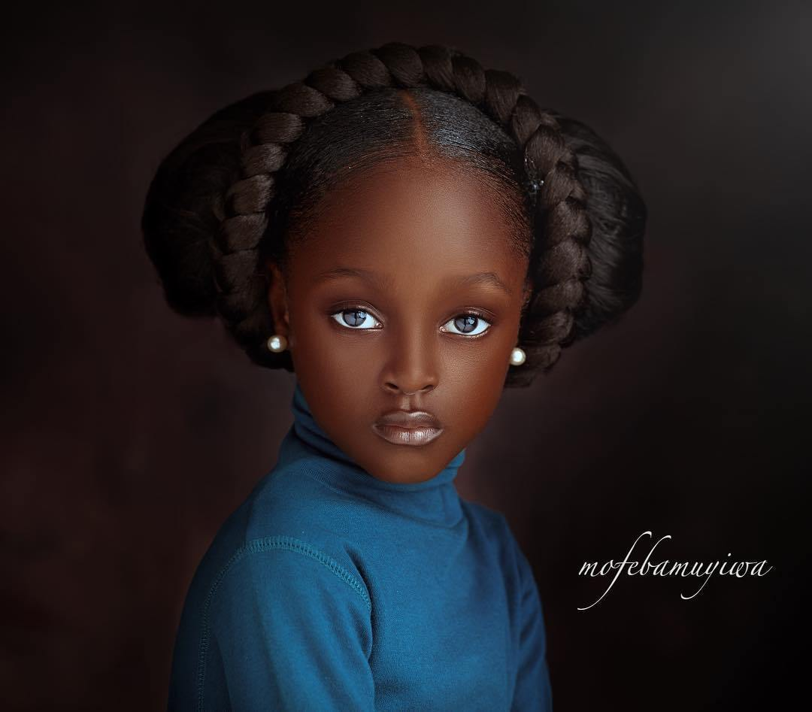
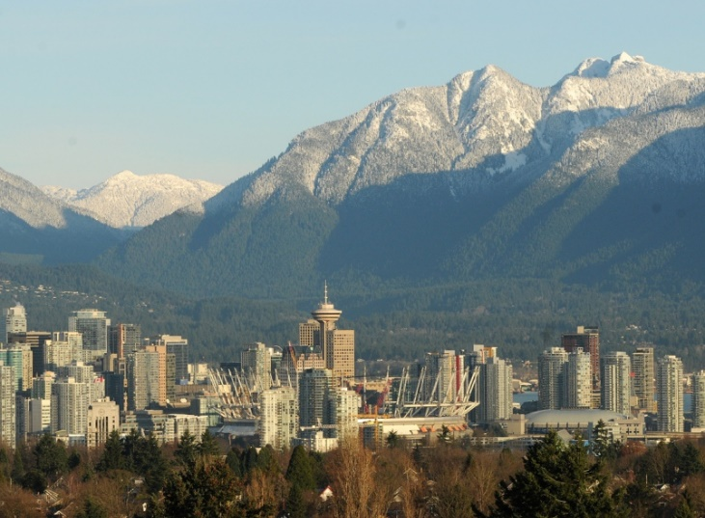

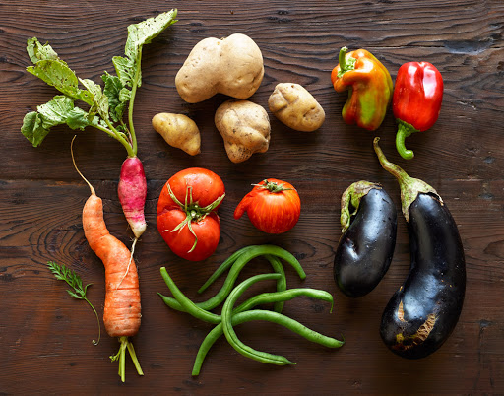
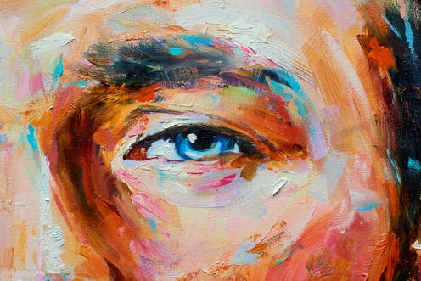
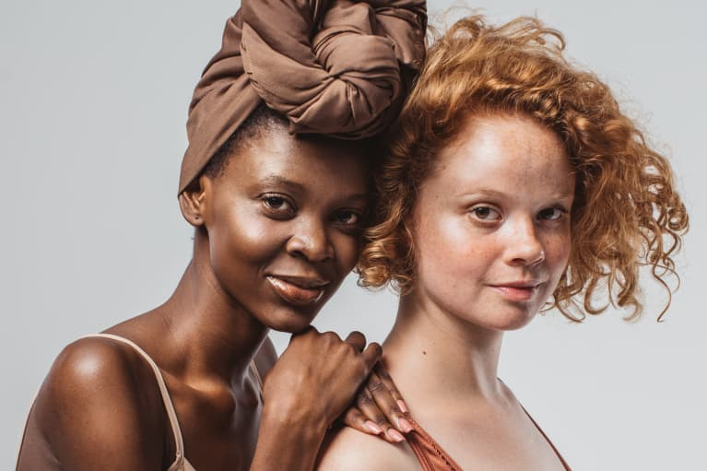
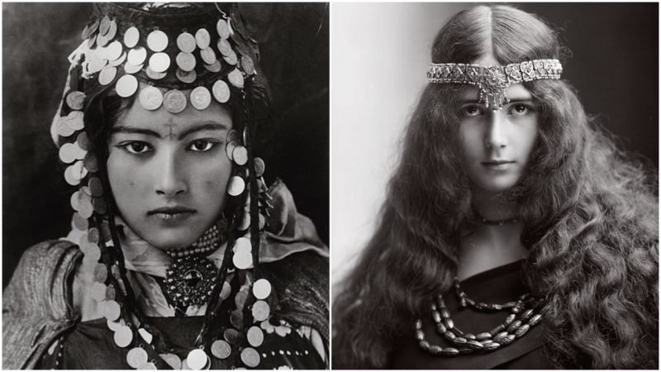
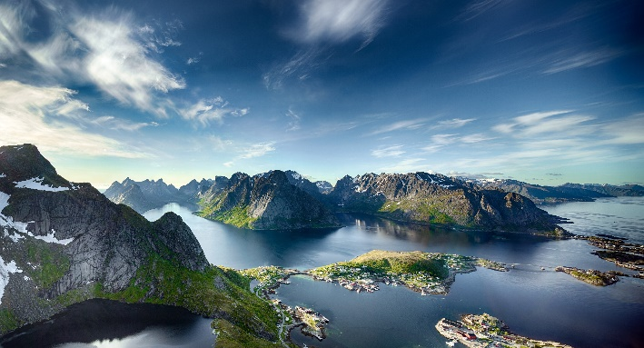
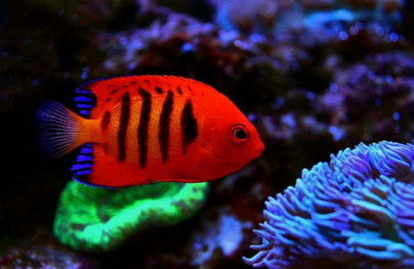
Value of Beauty
Notes:
This activity can be floated to the next meeting if needed – homework would still be the same
What do we consider beautiful?
These images are some items that came up when I typed beautiful into google images
We all have different ideas when it come to beauty…..
I want each of you to circle the image you think is most beautiful
Did we all circle the same one?
Can someone share why they circled the picture they did?
How do these various notions of beauty play out in your own life?
Would your friends have written the same items?
Do you stay true to your own notions of beauty when you decide what to wear to school? When you make comments on social media?
Do you use different filters to change somethings beauty?
Have your notions of beauty ever clashed with those of your friends? What was the result/how did you react?
Did you conform to match your friend, or did you stick with your own ideals?

Slide 12
Homework
I want you all to find an item you think is beautiful. It can be anything you have at home with you.
You are going to bring it to the next meeting.

Slide 13
Mission Sisterhood
Part Two

Slide 14
Slide Title
Meeting Norms:
-Staying muted unless asked to unmute by the presenter
-Only using the chat log for VTM related messages
-Use of appropriate language during VTMs
-Behavior modelling the GS Promise and Law
Notes:
And keep in mind…

Slide 15
Girl Scout Promise
and Law

Slide 16


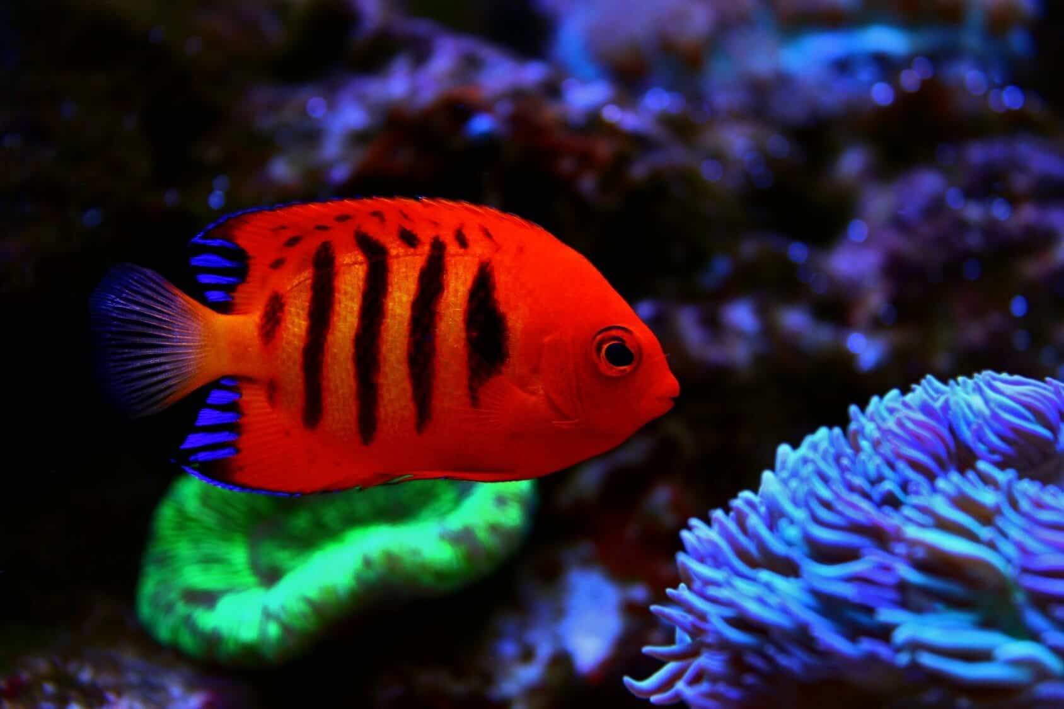

Value of Beauty
Notes:
Everyone bring out their beauty items we are going to break into groups and discuss why we brought that item

Slide 17
Friendship Circles
  Acquaintance: Someone you’re friendly with and know by name, but don’t know too much about (many friendships start as acquaintances).
  Good Friend: Someone with whom you share interests and enjoy spending time, even one on one, but your connection only goes so far—she’s just not the one you share your truest feelings with.
  Group Friend: Someone you hang out with and have a good time with as part of a larger group of friends, or a sport or other interest group—but your conversations don’t necessarily go too deep.
  Confidante: Someone you tell your deepest secrets and wildest dreams, and trust she will not divulge them (you turn to her in times of trouble and you know she always has your back).
  Role Model: Someone you look up to (can be found in any type of friend).
  Mentor: Someone who acts as a teacher and a guide (an adult, a peer, or an older girl) in a particular field or for a skill that you’re interested in.
  Networking Friend: Someone who helps you on your career path, and someone you help in return.
  Advisor: Someone who helps you work out issues and is supportive
Draw a friendship map
You will be in the middle and then moving out, you will place your friends into categories
We are going to use these to reflect on our relationships and how they support us
Notes:
If you want to add another category you do not see here you can
These are all the people in your life, they do not need to be your age, they can be any gender, they can not feel the same way about you

Slide 18
Mentor
Beth
Justin
Corey
Confidante
Ali
Husband
Keith
Acquaintance
my neighbors: Mamie, Jill
Me !
Hana
Good Friends
Jessica
Jessica
Summer
Rachel
Carly
Work Friends
Ape
Kristin
Kelly
Networking Friends
Jackie
Justin
Rachel
Notes:
This is mine, this is something like what yours should look like
Make sure to label all the bubbles and list the people in your life, if you forget someone it is ok, we can add them later
We are going to take about 10 minutes to create these and then we will share them
GO BACK TO THE SLIDE WITH THE CATAGORIES

Slide 19
Would any one like to share?
Notes:
Allow 5 minutes for sharing
Did anyone find anything interesting?
Did anyone add a new category?
Anyone find they had a hard time evaluating their friends?

Slide 20
Value of Friendship
What is a Value?
Notes:
Have the girls annotate what a value is, define what it means
Have the girls type onto the page
Official Definition: importance, worth, or usefulness of something
important and lasting beliefs or ideals shared by the members of a culture
Values have major influence on a person's behavior and attitude and serve as broad guidelines in all situations

Slide 21
What are some Values we look for in Friendships?
Notes:
Have the girls type in what they look for in friendships
How do these values align with the values that you and your family share?
How do these values align with the people you put into your friendship circles?
Is there anyone you need to move or change their position in your circles? (this could be good or negative)
Which values were most desired? Why do you think they ranked so high?
Which values listed are not at all important to you?
How many of the values listed echo ones in the Girl Scout Law?
I will do my best to be honest and fair, friendly and helpful, considerate and caring, courageous and strong, and responsible for what I say and do, and to respect myself and others, respect authority, use resources wisely, make the world a better place, and be a sister to every Girl Scout.
Are there any people on your chart that do not hold these values?
Do you see how these values are worthwhile for all friendships, and for sisterhood in general?
Wrap up by saying: When you’re aware of what you value in friendships, you can better understand why a friendship may not be going the way you’d like. You may even be able to foresee when a friendship may fade.

Slide 22
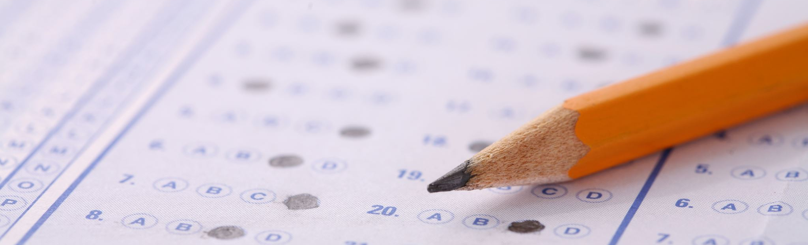
Homework
Measure of Friendship Quiz
  Take a few minutes to complete this and we will go over this at the beginning of tomorrow’s meeting
Notes:
You should choose different friends from different circles on your friendship map

Slide 23
Mission Sisterhood
Part Three

Slide 24
Slide Title
Meeting Norms:
-Staying muted unless asked to unmute by the presenter
-Only using the chat log for VTM related messages
-Use of appropriate language during VTMs
-Behavior modelling the GS Promise and Law
Notes:
And keep in mind…

Slide 25
Girl Scout Promise
and Law

Slide 26
Measure of Friendship
Take our your friendship quizzes
We will break into groups and discuss your findings
Notes:
What sort of patterns did you see when selecting your answers?
Checks in right-hand column means these friends make you feel safe & supported but aren’t afraid to give you constructive feedback. With them, you feel like you can voice your own opinion, try new things, and be the real you.
Checks in the left-hand column means these friends aren’t letting you be you. You’ve got some friendship work to engage friends who make friendship worthwhile.
How might you try to make changes to move friendships from the left-hand column to the right-hand column?
How can you use this to evaluate your current friendships and potential friendships

Slide 27

What is out new definition of Sisterhood

Slide 28
Sisterhood
What are some strengths of having a Sisterhood?
What are some challenges facing young women to build a strong Sisterhood?
Notes:
I will type out what they say so we have this for brainstorm

Slide 29

Take Action Project
A Take Action project is a chance for you to partner with others in your community to solve a problem.
We have been working on Sisterhood, and discovering what we need to feel good and have a strong Sisterhood
The next step is to focus on one aspect
  learn about the root causes of issues, mobilize and engage your community members and volunteers, and strive toward creating lasting change in your world.

Slide 30
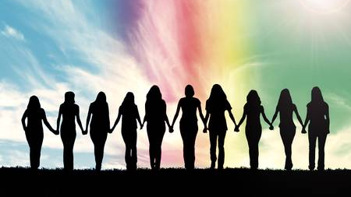
Planning your Take Action Project
Take out your action planning worksheet that was sent in the confirmation e-mail
Notes:
We are going to take a few minutes to use the brainstormed ideas to work on plan for a take action project

Slide 31
Brainstorm
What are some common themes we have seen through looking at ourselves and our friends?
What are some reoccurring issues we see?
What are some things we would like to see improved in ourselves and our friendships?

Slide 32
Brainstorm Ideas
Notes:
This is where we will type in our ideas from the brainstorm
Once all the ideas are up, have the girls think and plan what they want to do for a take action project

Slide 33
What is your Project?
Notes:
Have some girls share what their projects will be.

Slide 34

Final Steps
Complete
Complete your Take Action Project
Make a timeline
Spread your message
Go
Go For GOLD
To start your Gold Award application and process you must have completed 1 journey and your Silver Award or two journeys
Use this take action project as a practice for larger project

